Slide 1
NOSQL
Καλύβας Εμμανουήλ
Νταούλας Βασίλειος
Document stores

Slide 2
Content
Document stores
Key features of document stores
Differences between relational DBs
Disadvantages
Use cases

Slide 3
What is a document store?
A document store (also known as a document-oriented database or a document database) is a database that stores and retrieves information in documents (i.e. JSON or XML).
Non-relational databases. Instead of storing data in fixed rows and columns, document databases use flexible documents.
2-way access:
By key-value
By an attribute value
Flexible, Fast, Scalable, Schemaless

Slide 4

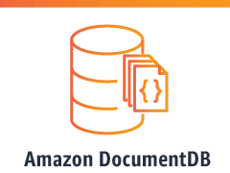



Examples

Slide 5
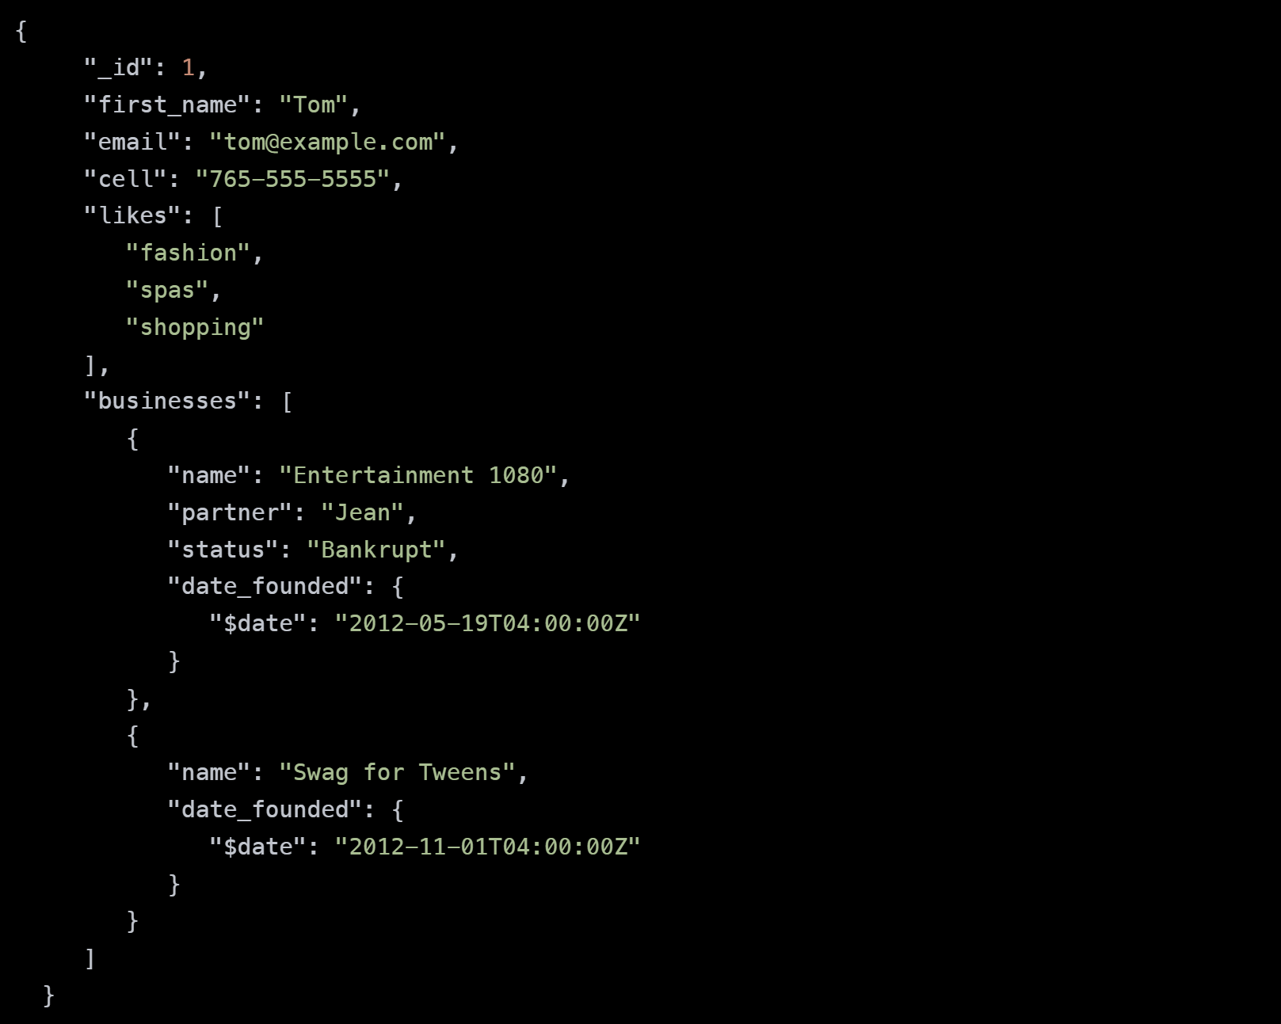
a JSON document that stores information about a user named Tom.

Slide 6
Key features
Data is stored in documents (unlike other databases that store data in structures like tables or graphs).
They have a flexible schema, meaning that not all documents in a collection need to have the same fields.
Document databases are distributed, which allows for horizontal scaling (typically cheaper than vertical scaling) and data distribution. Document databases provide resiliency through replication.
Document databases have an API or query language that allows developers to execute the CRUD operations on the database. Developers have the ability to query for documents based on unique identifiers or field values.
NOTE: a group of documents is called a collection

Slide 7
Example in MongoDB
Query:
db.people.update( { name: “John" }, {rating: 1, score: 1 }, { upsert: true } )

Slide 8
Differences between relational DBs
Documents map to the objects in code, so they are much more natural to work with. There is no need to decompose data across tables, run expensive joins, or integrate a separate Object Relational Mapping (ORM) layer. Data that is accessed together is stored together, so developers have less code to write and end users get higher performance.
The ubiquity of JSON documents
JSON documents are lightweight, language-independent, and human-readable. Documents are a superset of all other data models so developers can structure data in the way their applications need — rich objects, key-value pairs, tables, geospatial and time-series data, or the nodes and edges of a graph.
A document’s schema is dynamic and self-describing, so developers don’t need to first pre-define it in the database. Fields can vary from document to document. Developers can modify the structure at any time, avoiding disruptive schema migrations.

Slide 9
Relational vs Document-Oriented database representation
{
“id” : ”1”,
“name” : “John Smith”,
“isActive” : true
“DoB” : 1964-30-08”
}
{
“id” : ”2”,
“name” : “Sarah Jones”,
“isActive” : false
“DoB” : 2001-10-04”
}
{
“id” : ”3”,
“name” : “Eva Stark”,
“isActive” : true
“DoB” : 1994-12-09”
}
Document 1
id | name | isActive | DoB
1 | John Smith | true | 1964-30-08
2 | Sarah Jones | false | 2001-10-04
3 | Eva Stark | true | 1994-12-09
Document 2
Document 3

Slide 10
Disadvantages of document databases
Atomicity: For document databases, a change involving two collections will require you to run two separate queries (per collection). This breaks atomicity requirements.
Complexity: Not designed to handle relational data, lack of JOINs.
Security: Lack of ACID makes data less trustworthy sometimes, SQL injection.

Slide 11





Use cases

Slide 12
REFERENCES
Link: https://www.mongodb.com/document-databases
Link: https://database.guide/what-is-a-document-store-database/
Link: https://phoenixnap.com/kb/document-database
Lectures from lesson “Technologies for Big Data Analytics”

Slide 13
THANK YOU!

Slide 14
QUESTIONS

